Slide 1
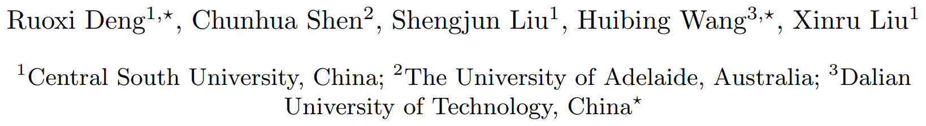
﻿﻿﻿ ﻿Learning to Predict Crisp Boundaries

Slide 2
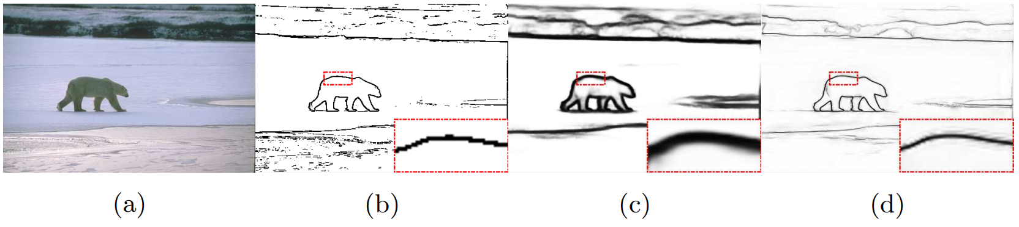
Crisp Edge detection
“Thick edge prediction”
﻿The CNN-Based algorithm tend to predict the thick edge (5~10 pixels wide)

Slide 3
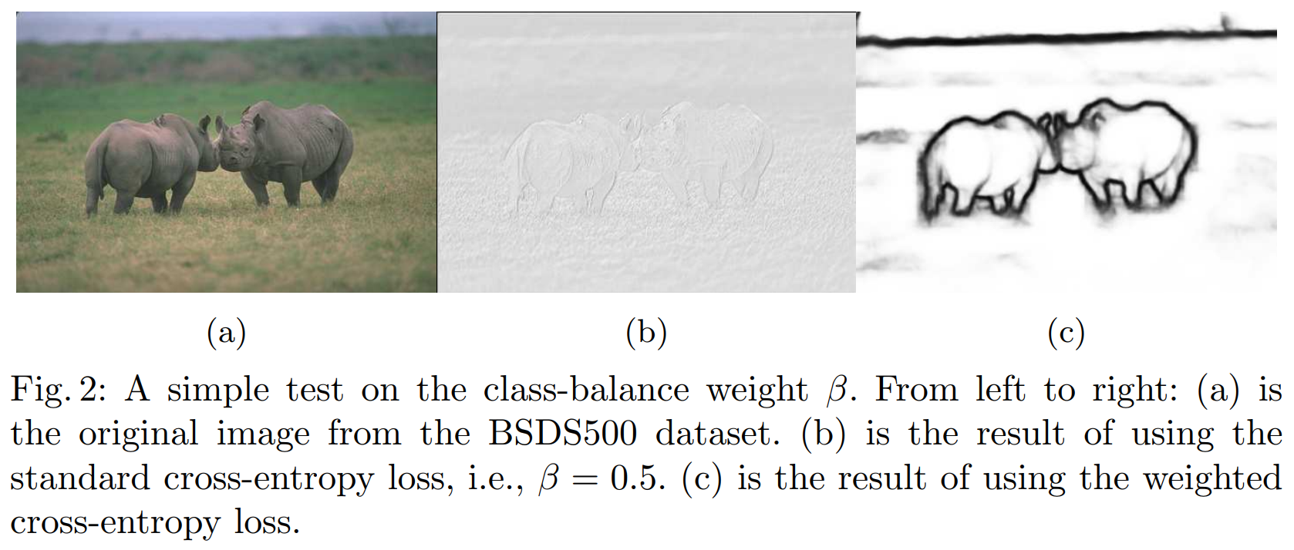
﻿Main Contribution

Slide 4
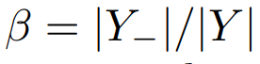
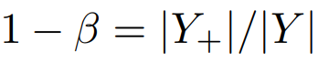
Rethinking the class-balanced weight CE Loss
Class-balanced weight
﻿The class-balance weights β and 1 − β are used to preserve and suppress the losses from the class of edge pixels and non-edge pixels, respectively
﻿This highly biased issue would cause the learning to fail to find the crisp edges which are the rare events.

Slide 5
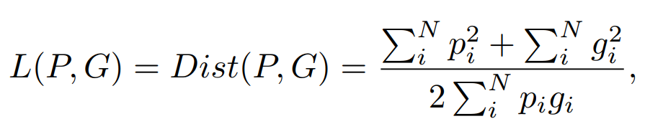
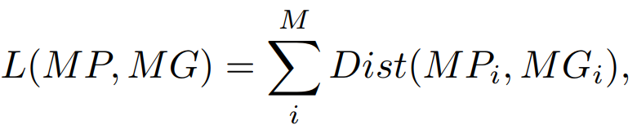
Method
Dice loss
﻿Since the Dice coefficient is a measure of similarity of two sets. Our loss is to compare the similarity of two sets P, G and minimizes their distance

Slide 6
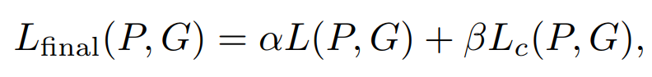
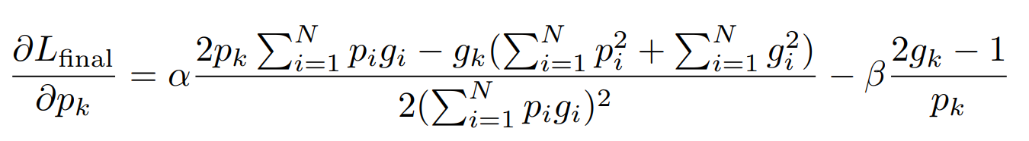
Method
Fusion loss: dice loss + cross-entropy loss
Backward Gradient

Slide 7
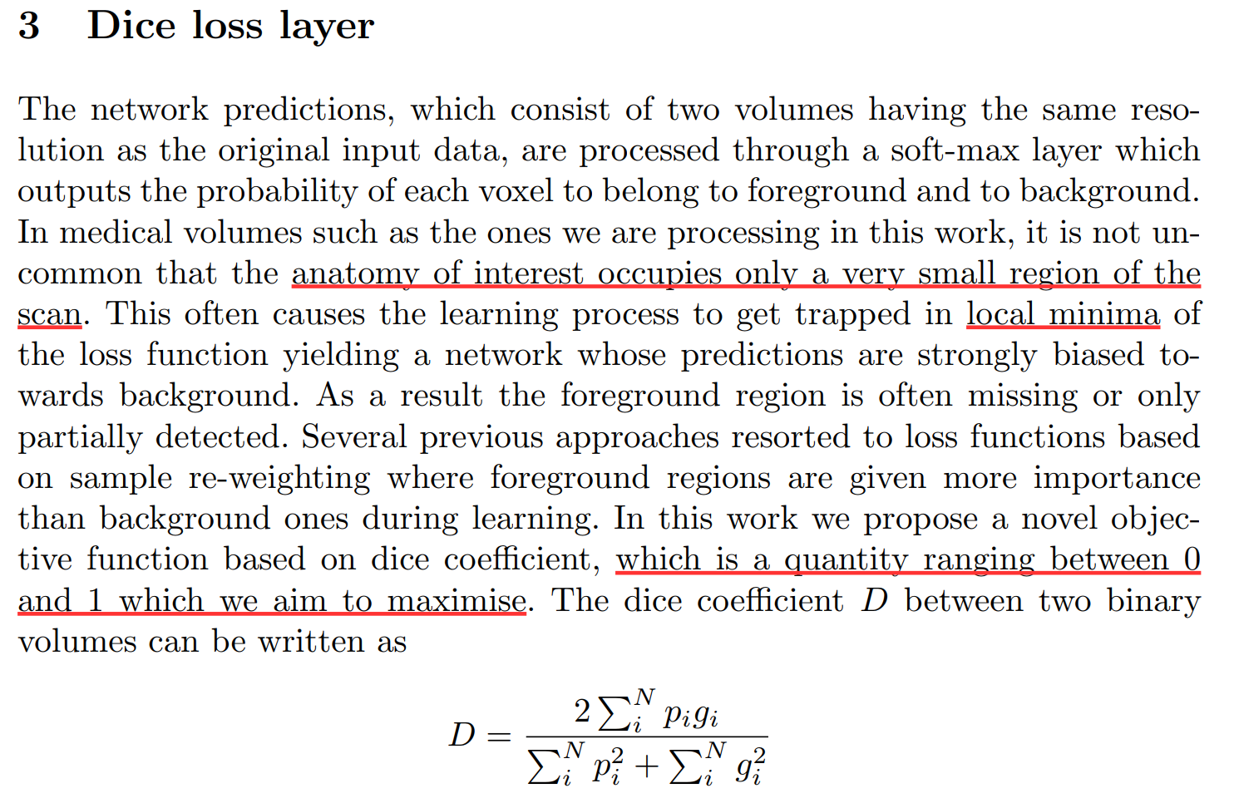
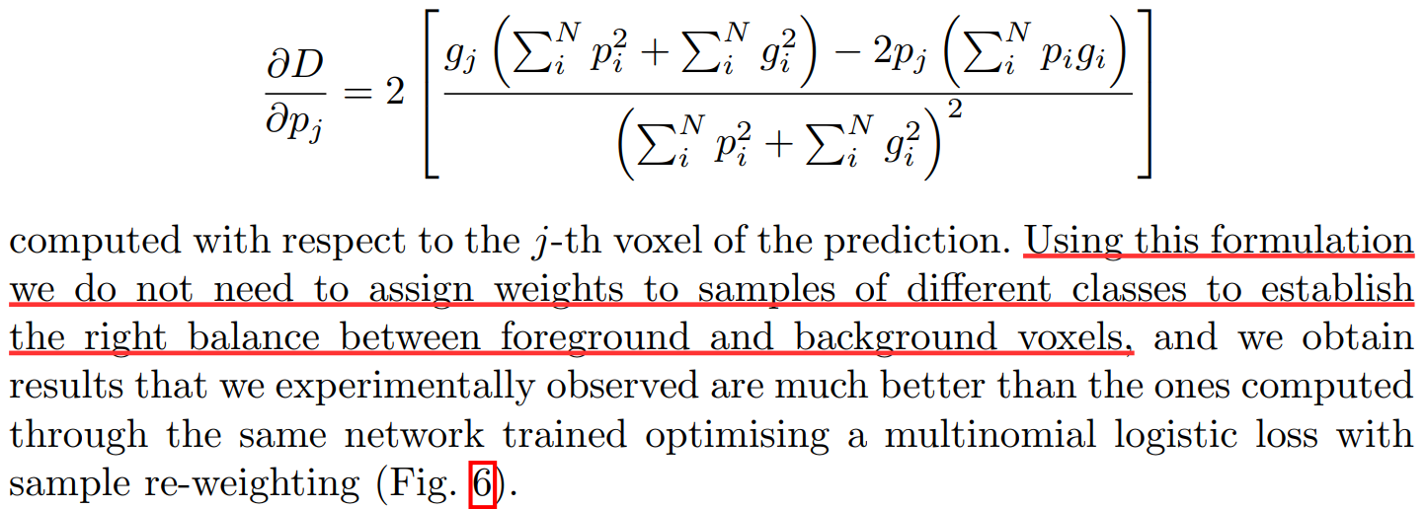
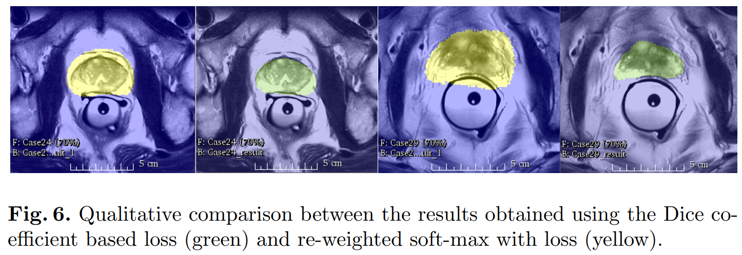
Reference
﻿V-Net: Fully Convolutional Neural Networks for Volumetric Medical Image Segmentation

Slide 8
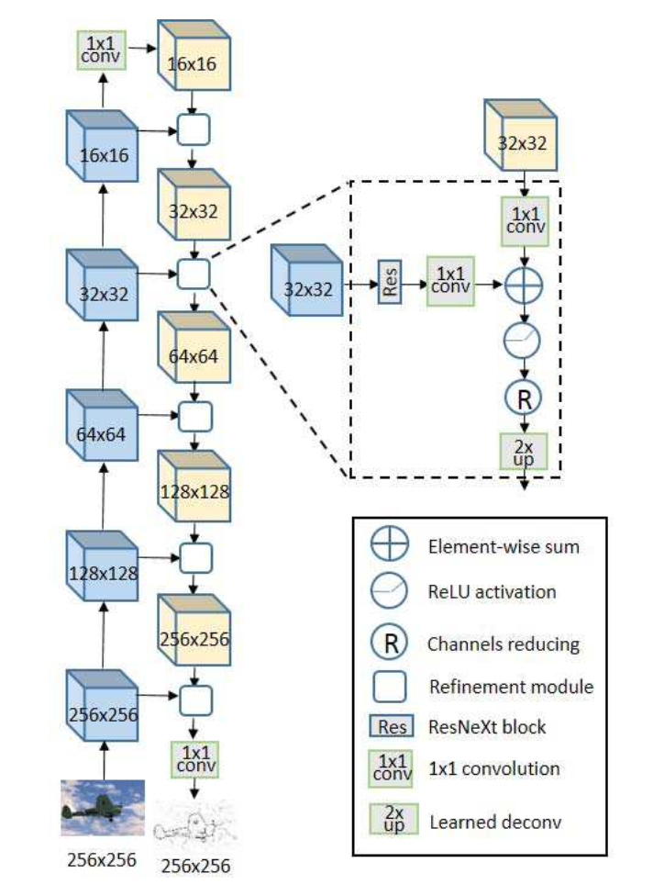
Method

Slide 9
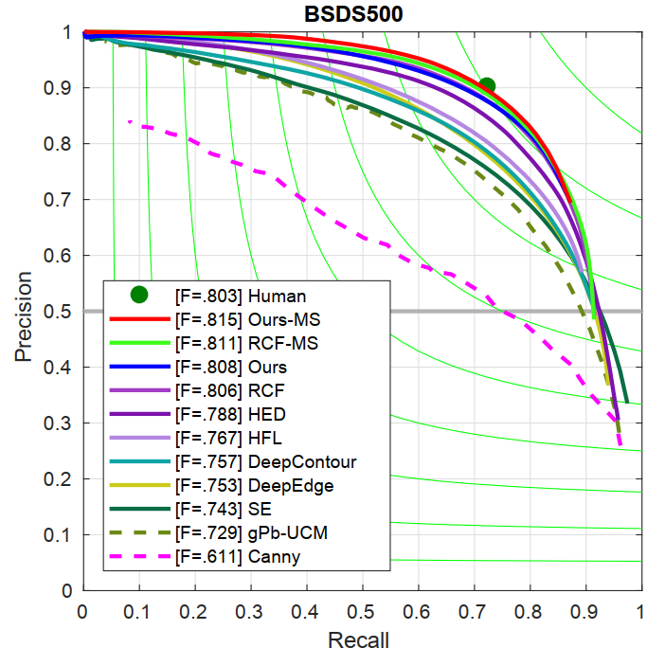
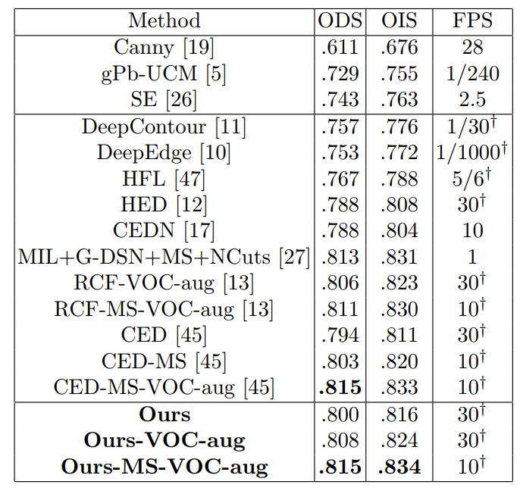
Result

Slide 10
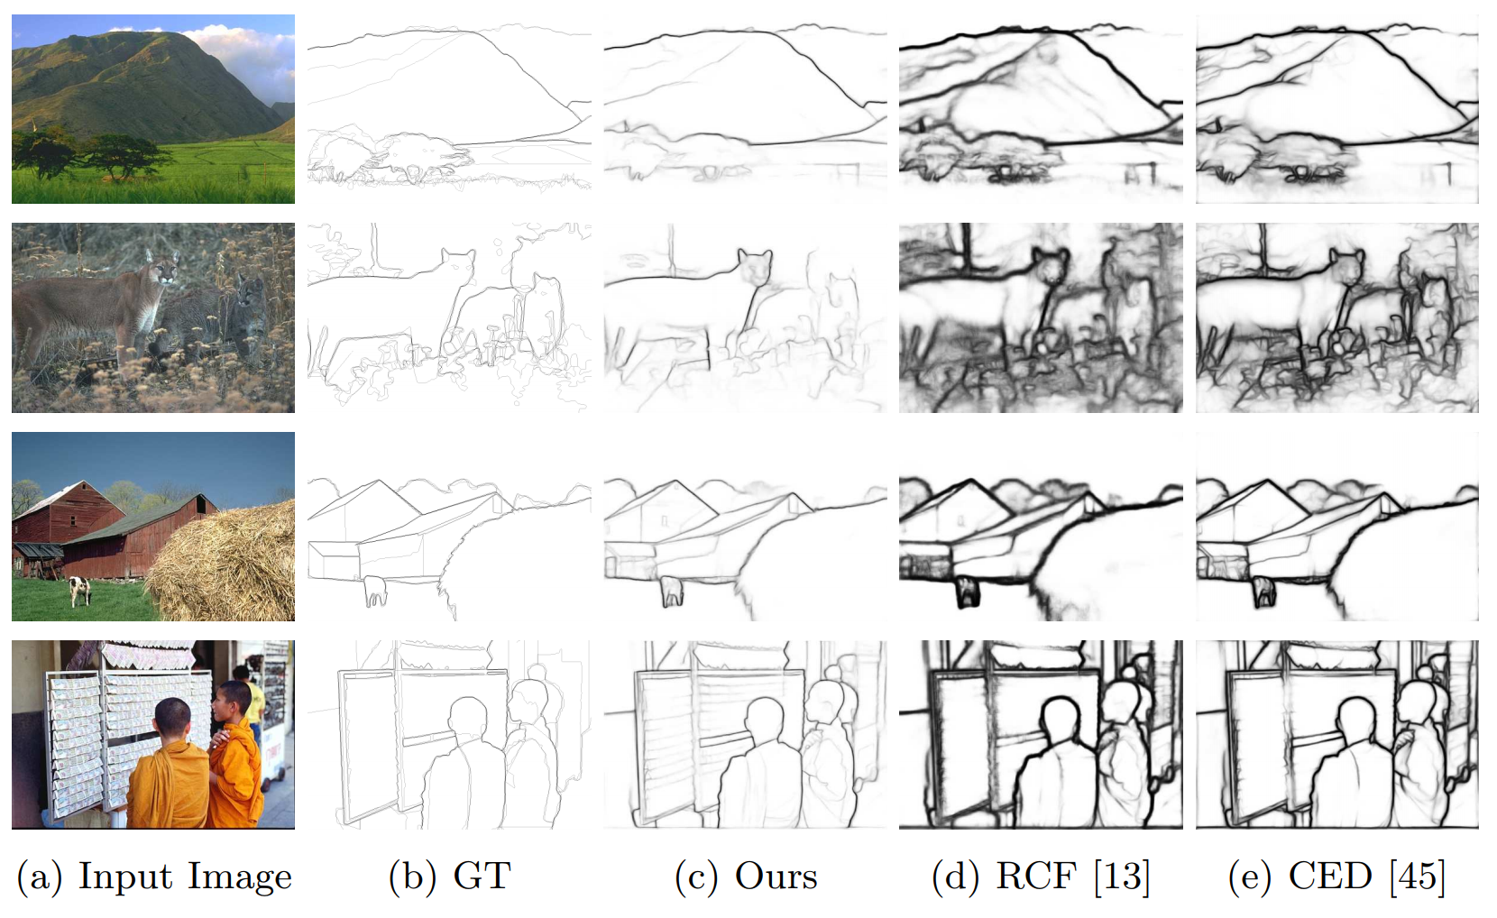
Result

Slide 11
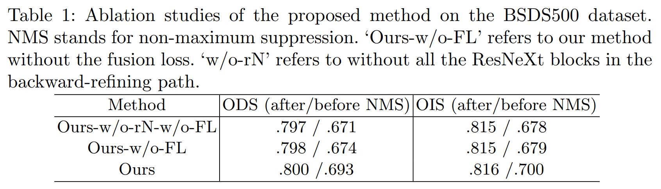
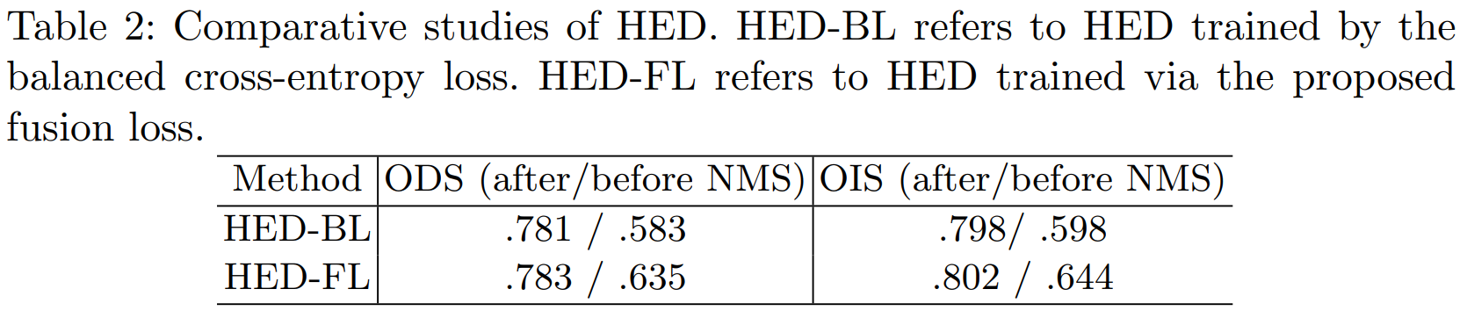
Ablation study

Slide 12
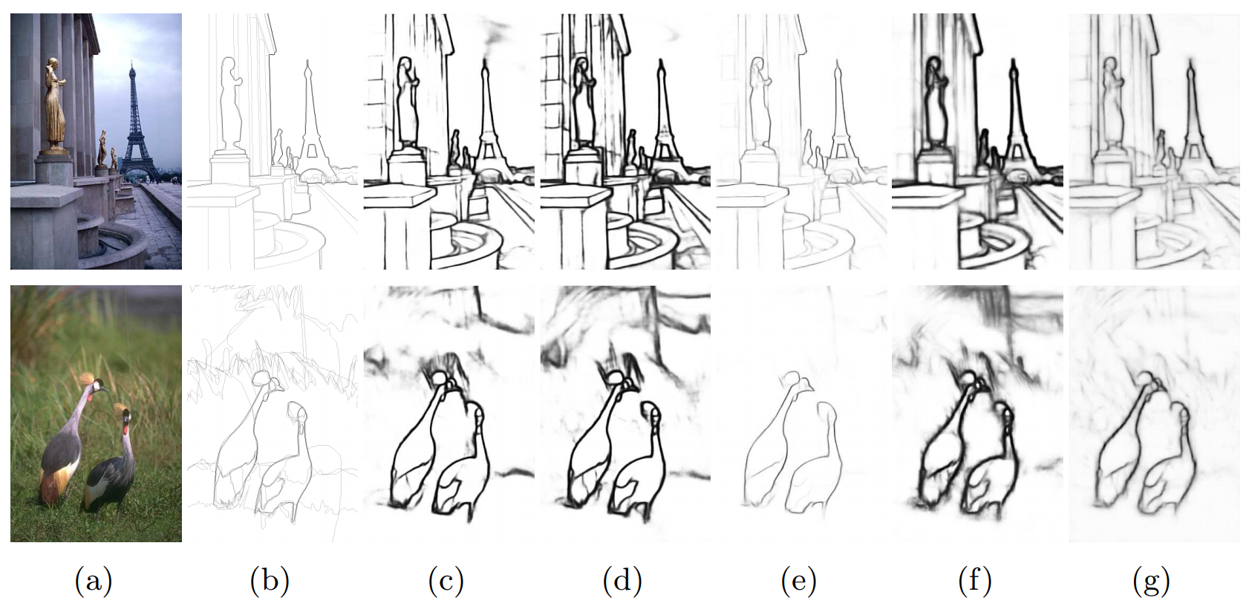
Ablation study

Slide 13
Related links
Dice-coefficient loss function vs cross-entropy
Link： https://stats.stackexchange.com/questions/321460/dice-coefficient-loss-function-vs-cross-entropy
2. 医学图像分割中的dice distance
Link： https://www.aiuai.cn/aifarm1159.html
3. 交叉熵损失
Link：https://www.aiuai.cn/aifarm124.html
4. V-Net
Link：https://arxiv.org/pdf/1606.04797.pdf

